Slide 1
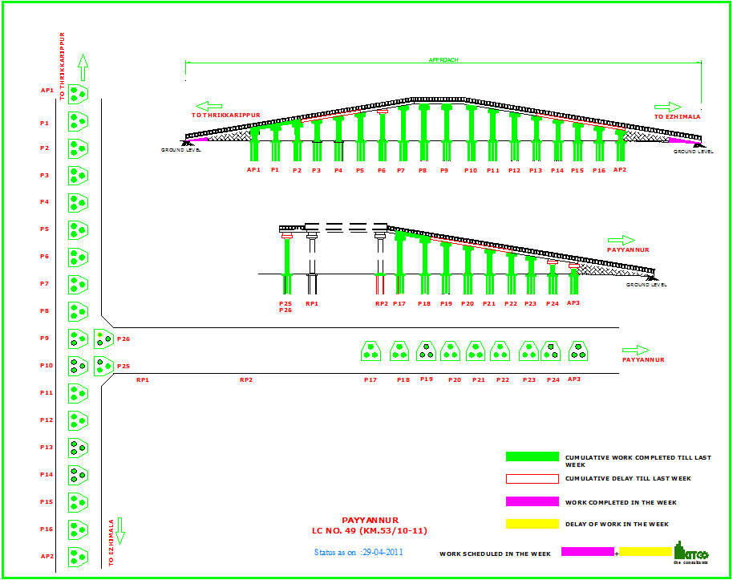
ROB at Payyannur Progress as on 29/04/11
Site Engineer : George Thampi (9995884056) Manager in charge : Dino Mani (9946201210)
KITCO RBDCK
1
Notes:
ROB at Payyannur1111111111111111111111111111111
1

